Slide 1


Sean Girgis
06/20/2022

Slide 2

Outline
Executive Summary
Introduction
Methodology
Results
Conclusion
Appendix

Slide 3
Executive Summary
Summary of methodologies
Data Collection through API
Data Collection with Web Scraping
Data Wrangling
Exploratory Data Analysis with SQL
Exploratory Data Analysis with Data Visualization
Interactive Visual Analytics with Folium
Machine Learning Prediction
Summary of all results
Exploratory Data Analysis result
Interactive analytics in screenshots
Predictive Analytics result

Slide 4
Introduction
Project background and context
SpaceX has achieved massive savings in the space industry. Using its Falcon 9 Rocket launches. SpaceX advertises a cost of just 62 million dollars compared to the typical 165 million dollars cost. Much of the savings was achieved via the re use of the captured stage one rockets. SpaceY is a new company that wants to bid against SpaceX for the rocket launching business. SpaceY has contracted us to study the data available to determine if SpaceY can compete with SpaceX. We will use different analytics techniques and create a machine learning pipeline to predict if the first stage will land successfully, in order to estimate the cost of launches.
Problems you want to find answers
Factors that affects successful launch
Inter-dependency of factors that affect successful launch
What conditions that SpaceY has to achieve so that it can have highest success probability of launches.

Slide 5

Section 1

Slide 6
Methodology
Executive Summary
Data collection methodology:
SpaceX Rest API
Web Scrapping from Wikipedia
Perform data wrangling
One-Hot encoding to prepare data for Machine Learning
Dropping of Irrelevant data
Perform exploratory data analysis (EDA) using visualization and SQL
Perform interactive visual analytics using Folium and Plotly Dash
Perform predictive analysis using classification models
How to build, tune, evaluate classification models

Slide 7
Data Collection
Data Collected from using get request to the SpaceX API
Collected data was turned to DataFrame using json_normalize()
Data cleaning and fill missing data when aproperiate
Collected more data using web scrapping from Wikipedia for Falcon 9 Launch records
Used BeautifuSoup data was parsed HTML tables.
Converted HTML table data into Pandas DataFrame

Slide 8
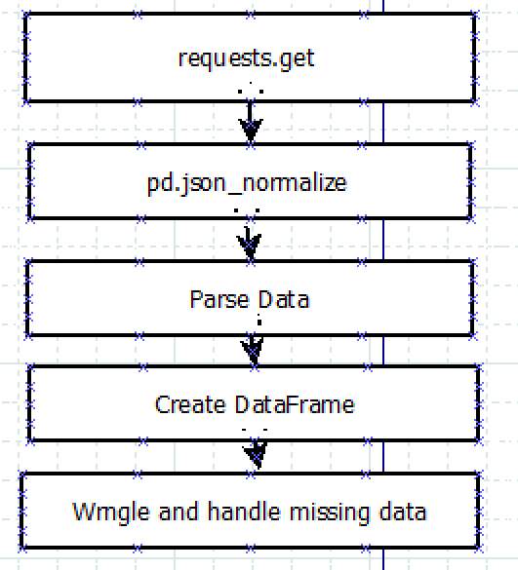
Data Collection – SpaceX API
Steps to data collection
Use requests.get to access information on API
Use pd.json_normalize to turn json data into dataframe
Parse internal data using helper methods such as getBoosterVersion, getLaunchSite, …
Create new launch_dict dataframe of looked up date
Handle missing data
Notebook on GitHub
IBM-Data-Science-Professional-Certificate/jupyter-labs-spacex-data-collection-api.ipynb at main · seang1968/IBM-Data-Science-Professional-Certificate (github.com)

Slide 9
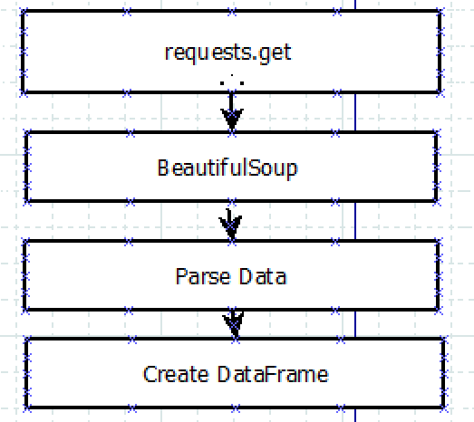
Data Collection - Scraping
Steps for Web Scrapping
requests.get to get webpage data
Use BeautifulSoup to parse HTML data
Parse data from HTML Tables for Launch information
Convert launch_dict into a DataFrame
Notebook on GitHub
IBM-Data-Science-Professional-Certificate/jupyter-labs-webscraping.ipynb at main · seang1968/IBM-Data-Science-Professional-Certificate (github.com)

Slide 10

Data Wrangling
Describe how data were processed
Calculate the number of launches on each site
Calculate the number and occurrence of each orbit
Calculate the number and occurence of mission outcome per orbit type
Create a landing outcome label from Outcome column
Calculate the percentage of success
Notebook on GitHub
IBM-Data-Science-Professional-Certificate/labs-jupyter-spacex-Data wrangling.ipynb at main · seang1968/IBM-Data-Science-Professional-Certificate (github.com)

Slide 11
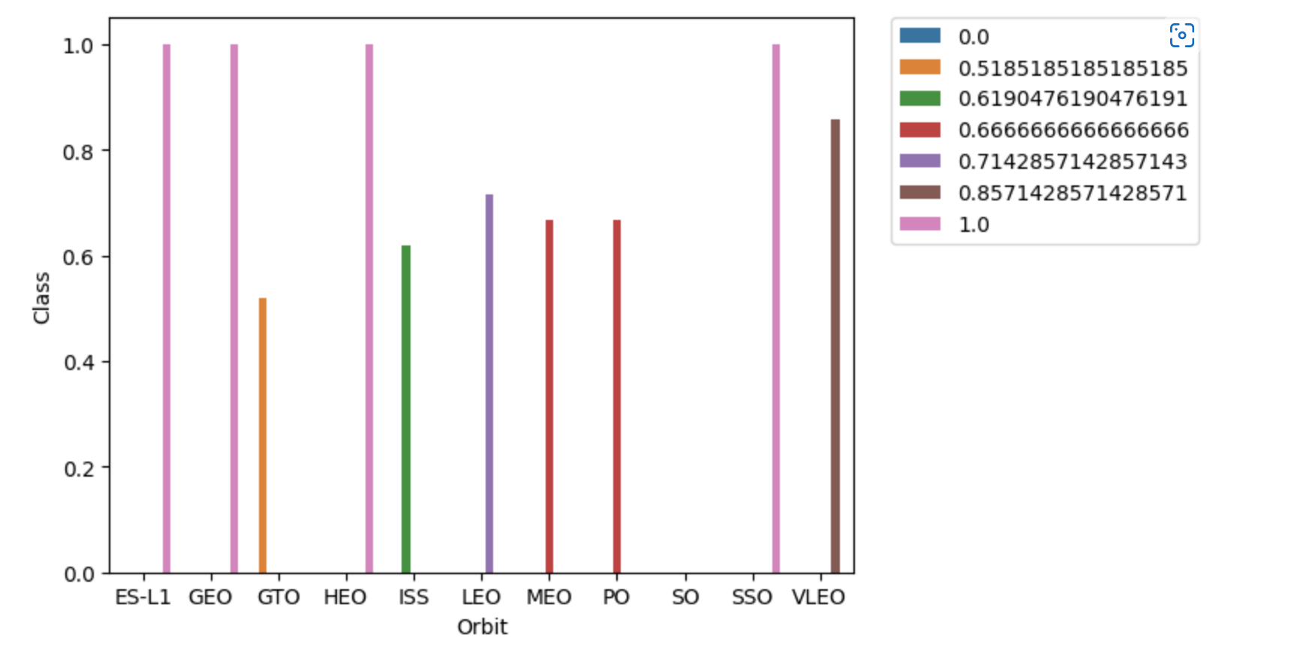
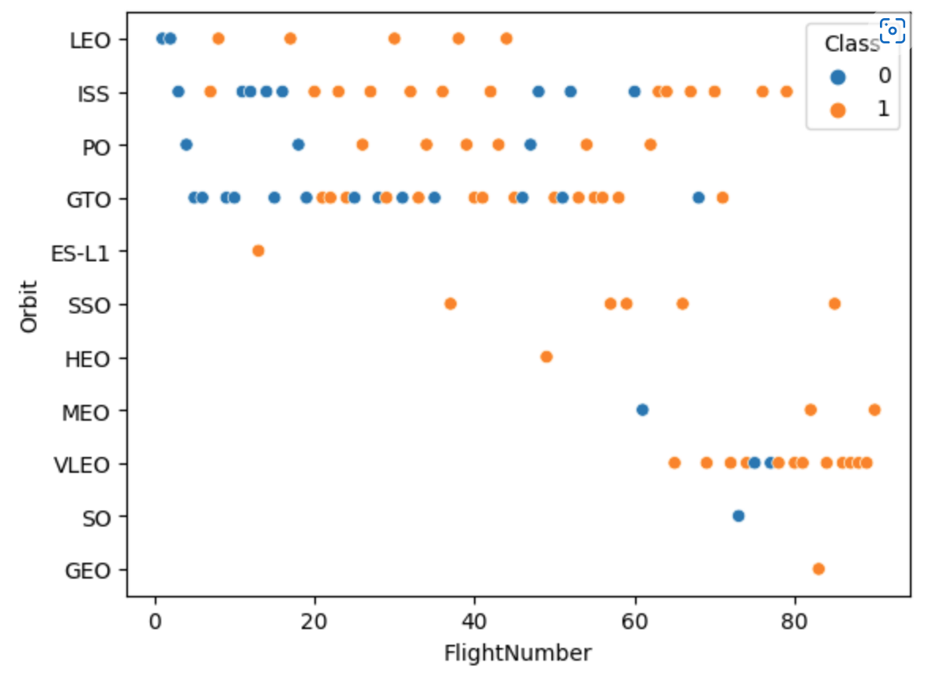
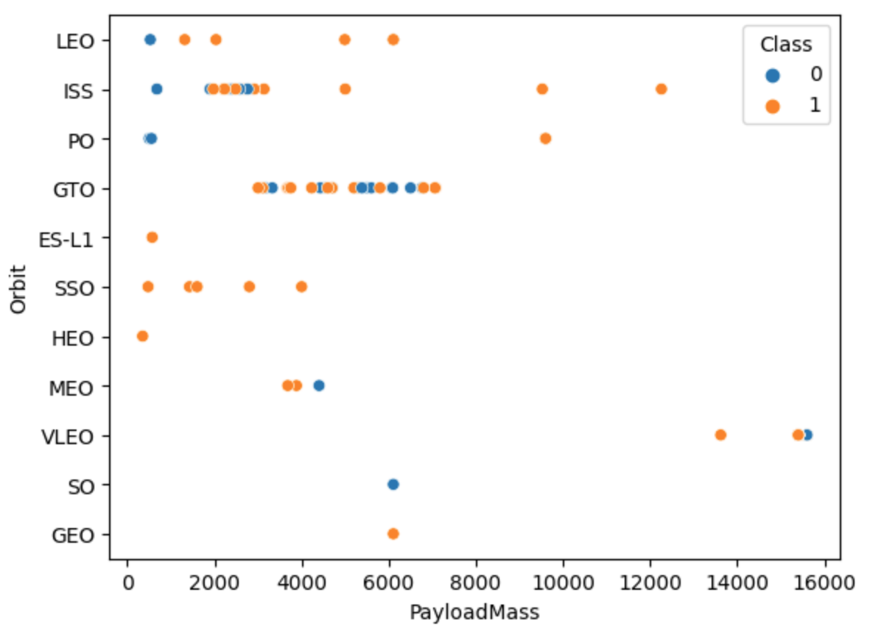
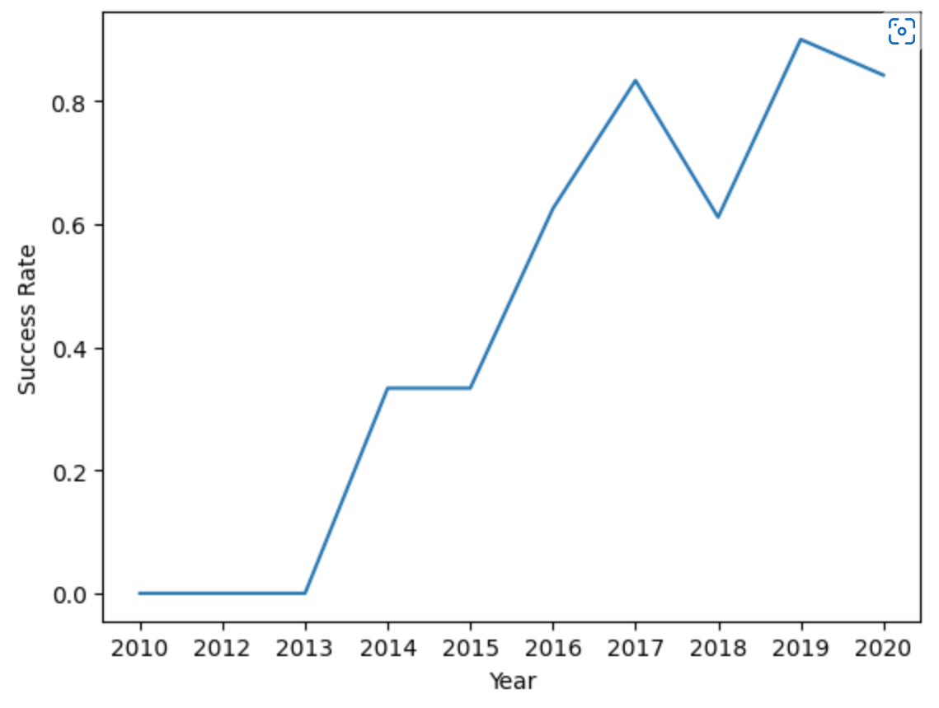
EDA with Data Visualization
We explored the data by visualizing the relationship between flight number and launch Site, payload and launch site, success rate of each orbit type, flight number and orbit type, the launch success yearly trend.
Notebook on GitHub
IBM-Data-Science-Professional-Certificate/jupyter-labs-eda-dataviz.ipynb at main · seang1968/IBM-Data-Science-Professional-Certificate (github.com)

Slide 12
EDA with SQL
We loaded the SpaceX dataset into a sqlite3 database without leaving the jupyter notebook.
We applied EDA with SQL to get insight from the data. We wrote queries to find out for instance:
The names of unique launch sites in the space mission.
The total payload mass carried by boosters launched by NASA (CRS)
The average payload mass carried by booster version F9 v1.1
The total number of successful and failure mission outcomes
The failed landing outcomes in drone ship, their booster version and launch site names.
Notebook on GitHub
IBM-Data-Science-Professional-Certificate/jupyter-labs-eda-sql-coursera_sqllite.ipynb at main · seang1968/IBM-Data-Science-Professional-Certificate (github.com)

Slide 13
Build an Interactive Map with Folium
We marked all launch sites, and added map objects such as markers, circles, lines to mark the success or failure of launches for each site on the folium map.
We assigned the feature launch outcomes (failure or success) to class 0 and 1.i.e., 0 for failure, and 1 for success.
Using the color-labeled marker clusters, we identified which launch sites have relatively high success rate.
We calculated the distances between a launch site to its proximities. We answered some question for instance:
Are launch sites near railways, highways and coastlines.
Do launch sites keep certain distance away from cities.
Notebook on GitHub
IBM-Data-Science-Professional-Certificate/Interactive Visual Analytics with Folium.ipynb at main · seang1968/IBM-Data-Science-Professional-Certificate (github.com)

Slide 14
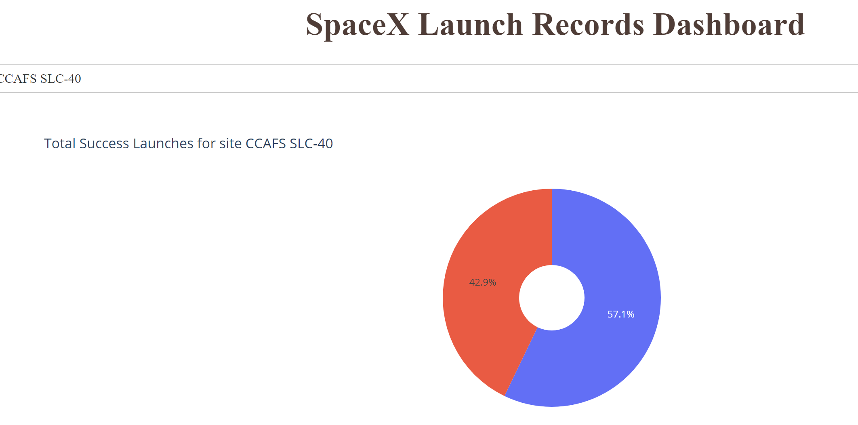
Build a Dashboard with Plotly Dash
We built an interactive dashboard with Plotly dash
We plotted pie charts showing the total launches by a certain sites
We plotted scatter graph showing the relationship with Outcome and Payload Mass (Kg) for the different booster version.
IBM-Data-Science-Professional-Certificate/app.py at main · seang1968/IBM-Data-Science-Professional-Certificate (github.com)

Slide 15
Predictive Analysis (Classification)
We loaded the data using numpy and pandas, transformed the data, split our data into training and testing.
We built different machine learning models and tune different hyperparameters using GridSearchCV.
We used accuracy as the metric for our model, improved the model using feature engineering and algorithm tuning.
We found the best performing classification model.
Notebook on GitHub
IBM-Data-Science-Professional-Certificate/SpaceX_Machine Learning Prediction_Part_5.ipynb at main · seang1968/IBM-Data-Science-Professional-Certificate (github.com)

Slide 16
Results
Exploratory data analysis results
Interactive analytics demo in screenshots
Predictive analysis results

Slide 17

Section 2

Slide 18
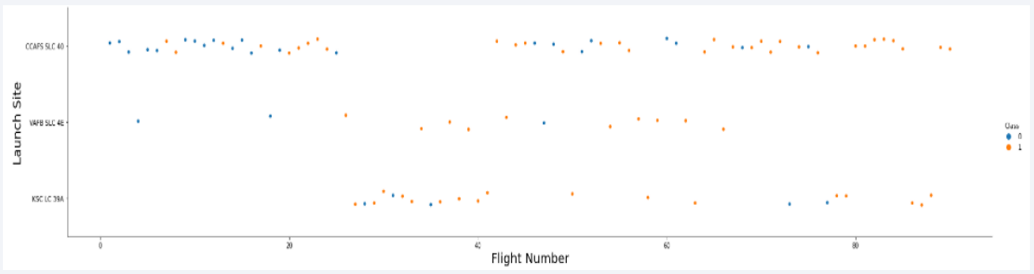
Flight Number vs. Launch Site
From the plot, we found that the larger the flight amount at a launch site, the greater the success rate at a launch site.

Slide 19
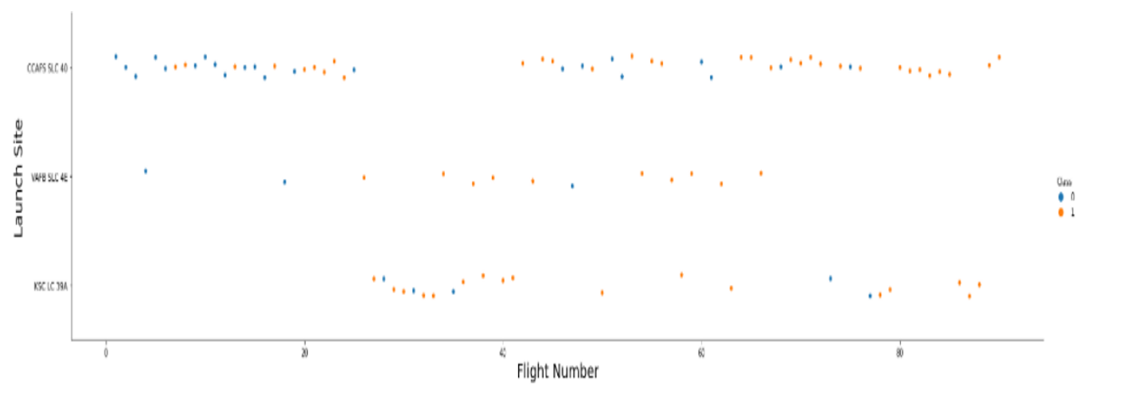
Payload vs. Launch Site
The greater the payload mass for launch site CCAFS SLC 40, the Higher the success rate for the rocket.

Slide 20
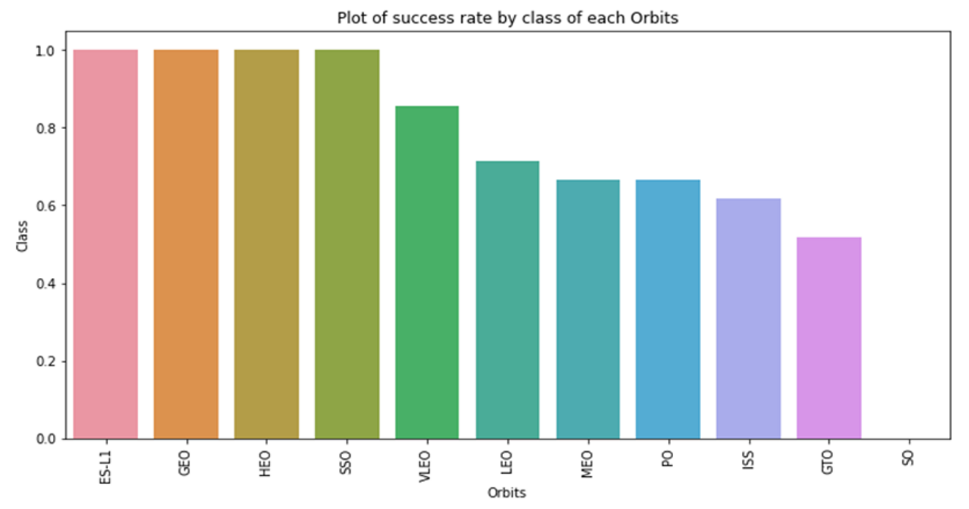
Success Rate vs. Orbit Type
From the plot, we can see that ES-L1, GEO, HEO, SSO, VLEO had the most success rate.

Slide 21
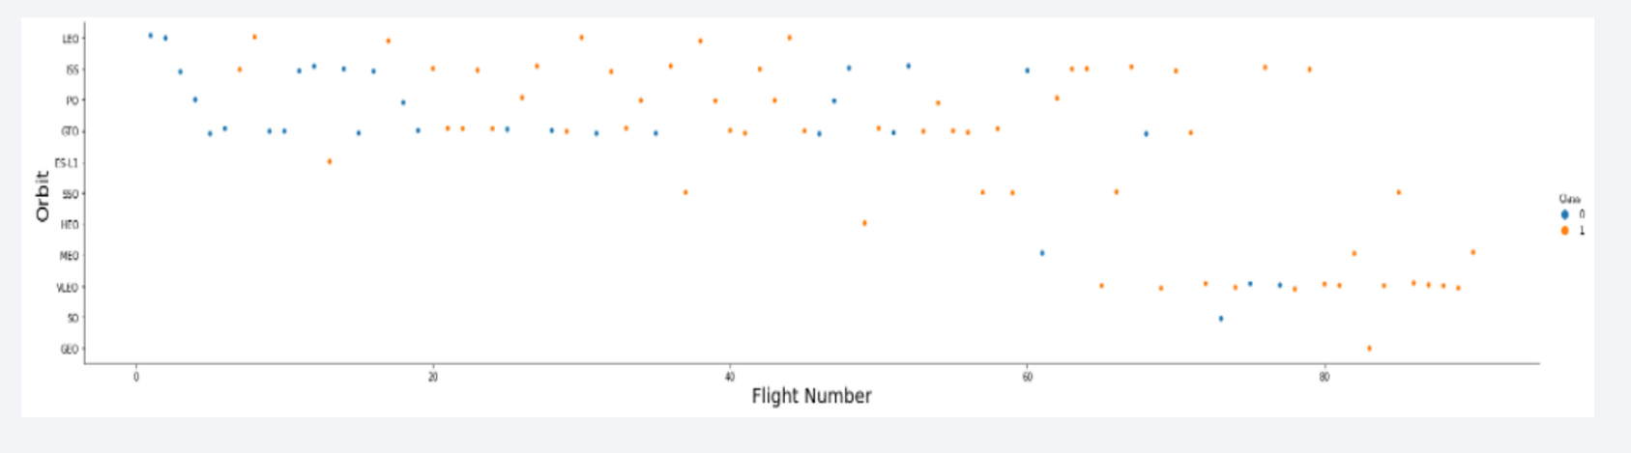
Flight Number vs. Orbit Type
The plot below shows the Flight Number vs. Orbit type. We observe that in the LEO orbit, success is related to the number of flights whereas in the GTO orbit, there is no relationship between flight number and the orbit.

Slide 22
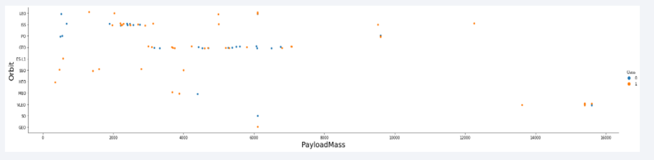
Payload vs. Orbit Type
We can observe that with heavy payloads, the successful landing are more for PO, LEO and ISS orbits.

Slide 23
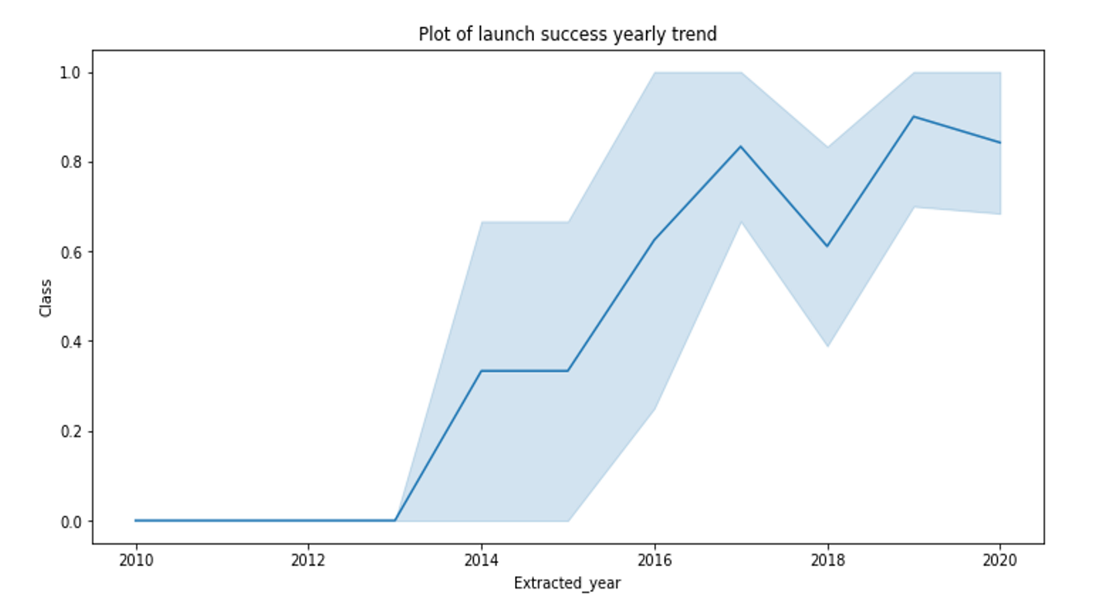
Launch Success Yearly Trend
From the plot, we can observe that success rate since 2013 kept on increasing till 2020.

Slide 24

All Launch Site Names
We used the key word DISTINCT to show only unique launch sites from the SpaceX data.

Slide 25

Launch Site Names Begin with 'CCA'

Slide 26
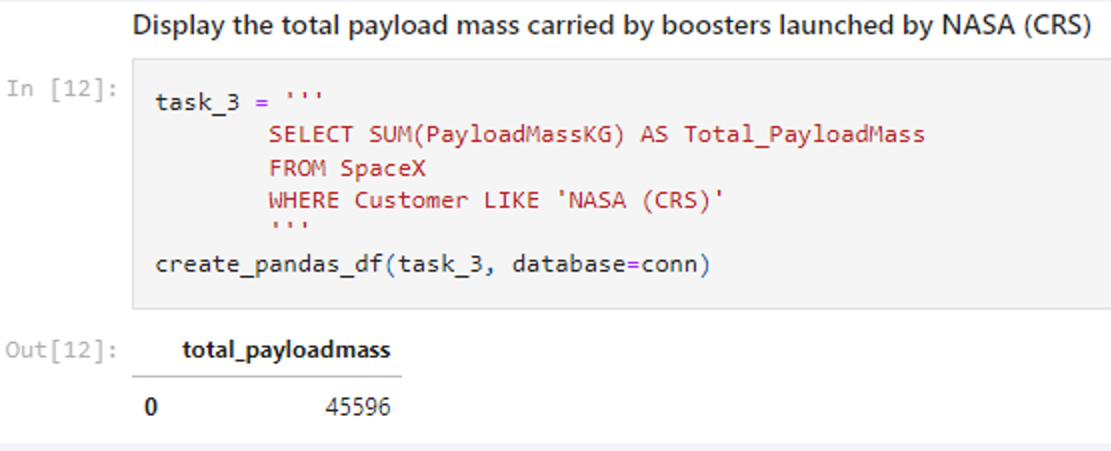
Total Payload Mass
We calculated the total payload carried by boosters from NASA as 45596 using the query below

Slide 27
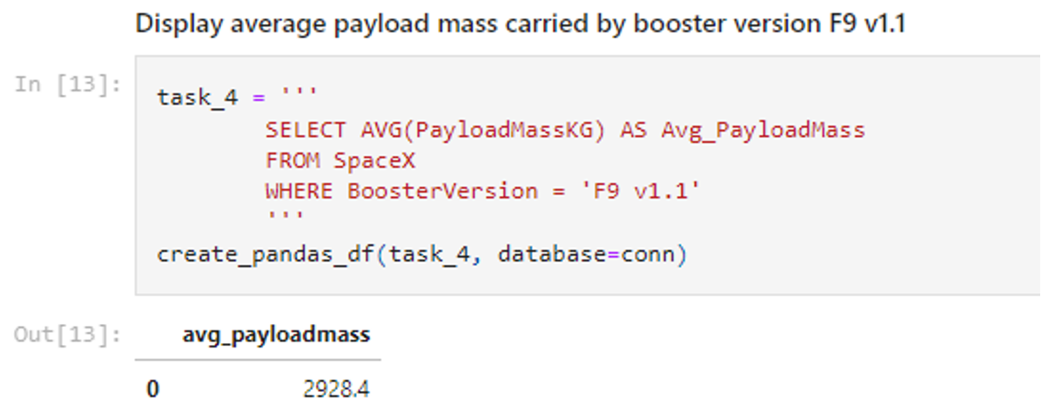
Average Payload Mass by F9 v1.1
We calculated the average payload mass carried by booster version F9 v1.1 as 2928.4

Slide 28
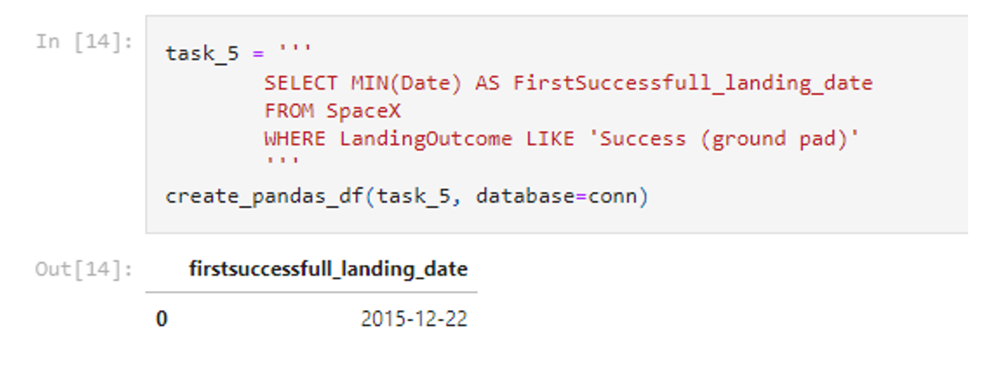
First Successful Ground Landing Date
We observed that the dates of the first successful landing outcome on ground pad was 22nd December 2015

Slide 29
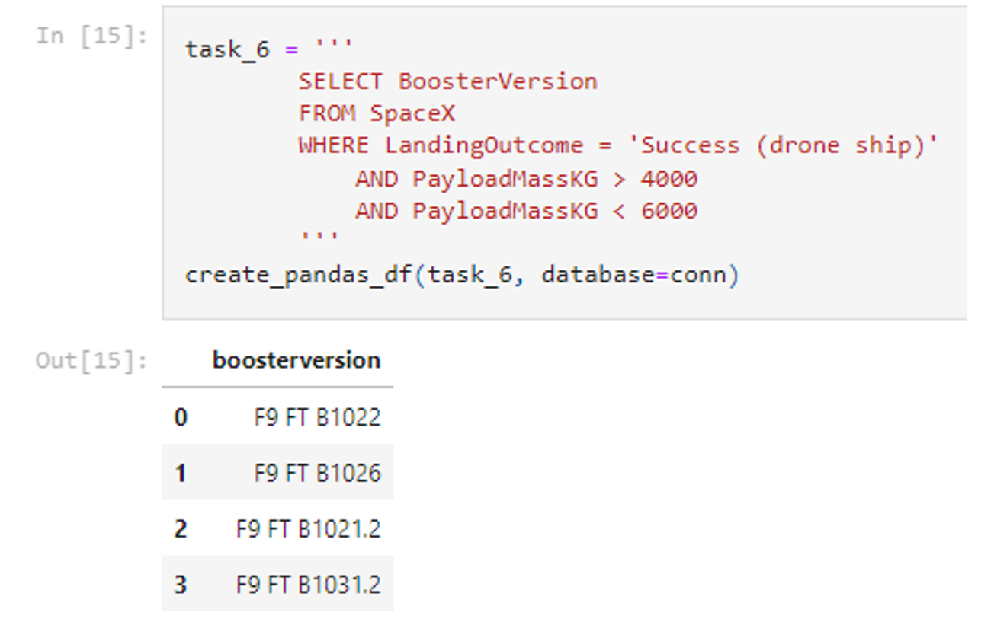
Successful Drone Ship Landing with Payload between 4000 and 6000
We used the WHERE clause to filter for boosters which have successfully landed on drone ship and applied the AND condition to determine successful landing with payload mass greater than 4000 but less than 6000

Slide 30
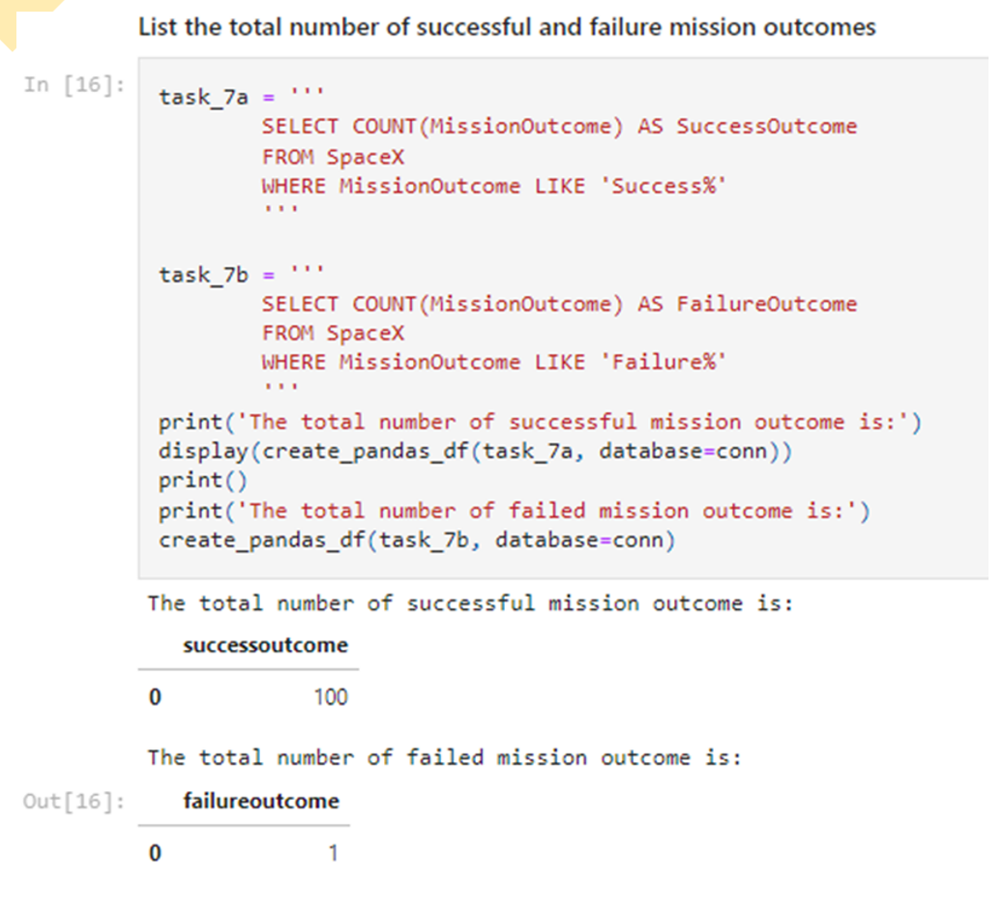
Total Number of Successful and Failure Mission Outcomes
We used wildcard like ‘%’ to filter for WHERE MissionOutcome was a success or a failure.

Slide 31
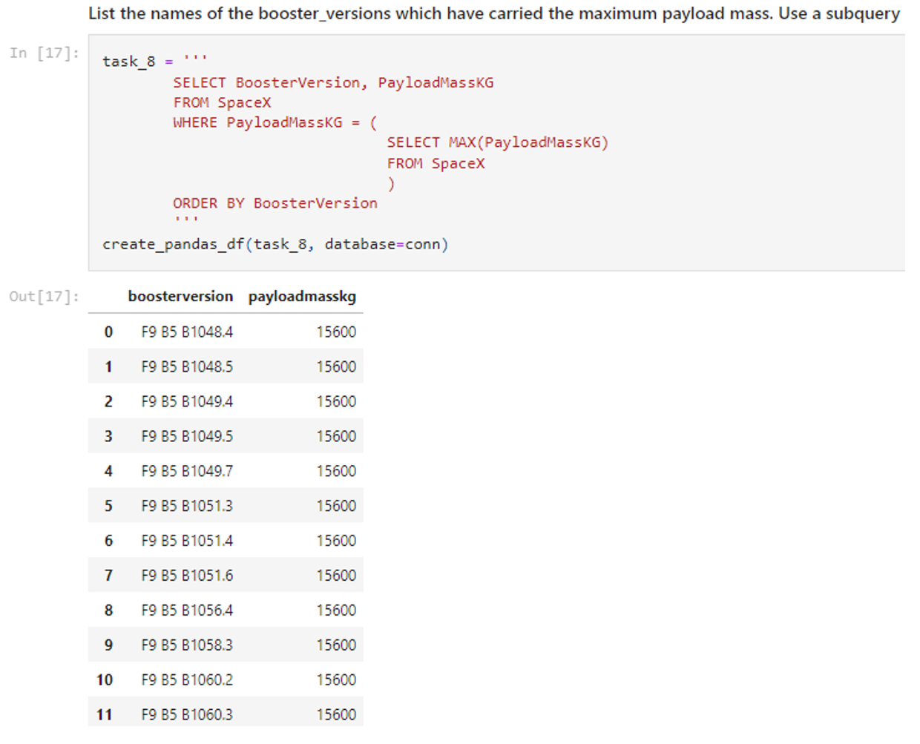
Boosters Carried Maximum Payload
We determined the booster that have carried the maximum payload using a subquery in the WHERE clause and the MAX() function.

Slide 32
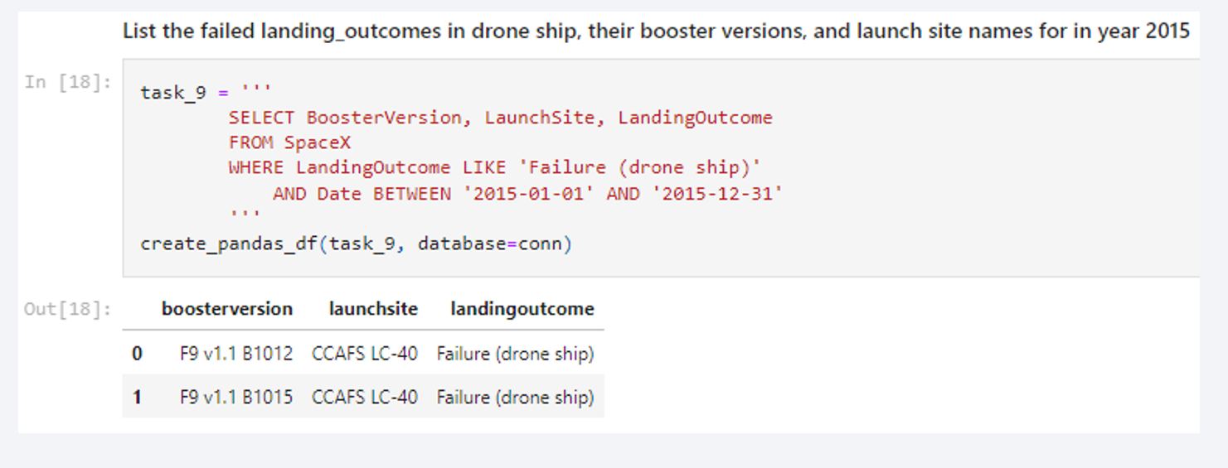
2015 Launch Records
We used a combinations of the WHERE clause, LIKE, AND, and BETWEEN conditions to filter for failed landing outcomes in drone ship, their booster versions, and launch site names for year 2015

Slide 33

Rank Landing Outcomes Between 2010-06-04 and 2017-03-20
Rank the count of landing outcomes (such as Failure (drone ship) or Success (ground pad)) between the date 2010-06-04 and 2017-03-20, in descending order
resent yur query result with a short explanation here

Slide 34

Section 3

Slide 35

All launch sites global map markers

Slide 36

Markers showing launch sites with color labels

Slide 37

Launch Site distance to landmarks

Slide 38

Section 4

Slide 39

Pie chart showing the success percentage achieved by each launch site

Slide 40

Pie chart showing the Launch site with the highest launch success ratio

Slide 41

Scatter plot of Payload vs Launch Outcome for all sites, with different payload selected in the range slider

Slide 42

Section 5

Slide 43
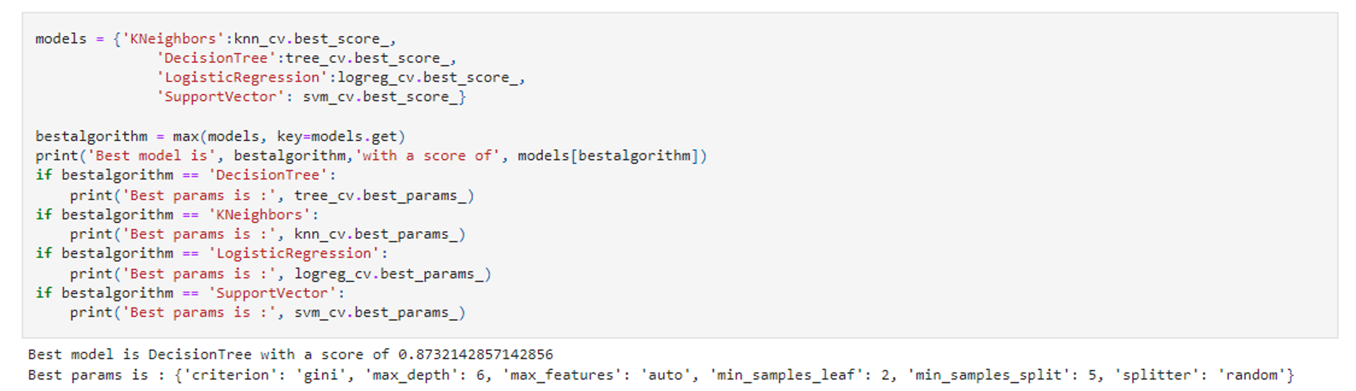
Classification Accuracy
The decision tree classifier is the model with the highest classification accuracy

Slide 44

Confusion Matrix
The confusion matrix for the decision tree classifier shows that the classifier can distinguish between the different classes. The major problem is the false positives .i.e., unsuccessful landing marked as successful landing by the classifier.

Slide 45
Conclusions
We can conclude that:
The larger the flight amount at a launch site, the greater the success rate at a launch site.
Launch success rate started to increase in 2013 till 2020.
Orbits ES-L1, GEO, HEO, SSO, VLEO had the most success rate.
KSC LC-39A had the most successful launches of any sites.
The Decision tree classifier is the best machine learning algorithm for this task.

Slide 46


